Slide 1
CXR Interpretation in Cardiology
13C討論室
2017/08/28
吳勃銳

Slide 2
Outline
Technical Considerations
General Principles
Lungs and Pulmonary Vasculature
Cardiac Chambers and Great Vessels
Pericardium
Additional Specific Considerations

Slide 3
Outline
Technical Considerations
General Principles
Lungs and Pulmonary Vasculature
Cardiac Chambers and Great Vessels
Pericardium
Additional Specific Considerations

Slide 4
Technical Considerations – (1/2)
Usual CXR consist of a frontal view and a lateral view
Frontal view: Standing PA view
Lateral view: Standing left lateral view
Heart size: PA view < AP view
Braunwald's Heart Disease: A Textbook of Cardiovascular Medicine, 10th Edition

Slide 5
Technical Considerations – (2/2)
Portable CXR
Supine or Semisupine position → Decreased depth of inspiration
Relatively larger heart
Less optimal visualization of the lungs
Poorer resolution
Most useful for answering relatively simple mechanical questions
Braunwald's Heart Disease: A Textbook of Cardiovascular Medicine, 10th Edition
Notes:
Portable CXRs are most useful for answering relatively simple mechanical questions, such as whether a pacemaker or implantable cardioverter-defibrillator (ICD) is properly positioned, whether an endotracheal tube is in the correct location, and whether the mediastinum is midline.2-4 They are not generally good at providing physiologic or complex anatomic information, and there are questions that cannot be answered accurately from a portable CXR

Slide 6
Frontal View

Slide 7
Lateral View

Slide 8
Outline
Technical Considerations
General Principles
Lungs and Pulmonary Vasculature
Cardiac Chambers and Great Vessels
Pericardium
Additional Specific Considerations

Slide 9
General Principles – (1/2)
Systematic approach to the evaluation of CXR
Define which type of CXR study is being evaluated
PA or AP view; Portable or not
Determine whether previous CXRs are available for comparison
Braunwald's Heart Disease: A Textbook of Cardiovascular Medicine, 10th Edition

Slide 10
General Principles – (2/2)
ABCDEFGHI
Assessment of quality / Airway
Bones and soft tissues
Cardiac
Diaphragm
Effusions / Extrathoracic soft tissue
Fields, fissures and foreign bodies
Great vessels / Gastric bubble
Hila and mediastinum
Impression
http://radiopaedia.org/

Slide 11
Outline
Technical Considerations
General Principles
Lungs and Pulmonary Vasculature
Cardiac Chambers and Great Vessels
Pericardium
Additional Specific Considerations

Slide 12
Lungs and Pulmonary Vasculature – (1/4)
Best to define pulmonary vascularity
Looking at the middle zone of the lungs
Comparing a region in the upper portion of the lungs with a region in the lower portion
Vessels should be larger in the lower part of the lung
Difficult to define in the outer third of the lung
Braunwald's Heart Disease: A Textbook of Cardiovascular Medicine, 10th Edition

Slide 13
Lungs and Pulmonary Vasculature – (2/4)
Increased PA flow
Pulmonary vessels are more prominent than usual in the periphery of the lung
Uniformly enlarged vessels and can be traced almost to the pleura
Increased LVEDP or LA pressure
Vessel borders become hazy, the lower zone vessels constrict, and the upper zone vessels enlarge
Interstitial edema increases
Pulmonary edema develops
Braunwald's Heart Disease: A Textbook of Cardiovascular Medicine, 10th Edition

Slide 14
Lungs and Pulmonary Vasculature – (3/4)
Reasonably good correlation between the pulmonary vascular pattern and pulmonary capillary wedge pressure (PCWP)
PCWP < 8 mmHg → Normal vascular pattern
PCWP 10 to 12 mmHg → Vessels in the lower zone appear equal in diameter to or smaller than vessels in the upper zone
PCWP 12 to 18 mm Hg → Vessel borders become progressively hazier
PCWP >18 to 20 mmHg → Pulmonary edema
Braunwald's Heart Disease: A Textbook of Cardiovascular Medicine, 10th Edition
Notes:
plethora

Slide 15
Lungs and Pulmonary Vasculature – (4/4)
Chronic heart failure
Chronic changes in the pulmonary vascular pattern
Elevation of LVEDP to 25 to 30 mm Hg may have a normal pulmonary vascular pattern
Braunwald's Heart Disease: A Textbook of Cardiovascular Medicine, 10th Edition

Slide 16
Outline
Technical Considerations
General Principles
Lungs and Pulmonary Vasculature
Cardiac Chambers and Great Vessels
Pericardium
Additional Specific Considerations

Slide 17
Cardiac Chambers and Great Vessels – (1/7)
Advantages of CXR over echocardiography, cardiac MR and cardiac CT
Allow fairly straightforward assessment of current status and changes over time
Routinely and readily available
Inexpensive
Carry a low radiation dose
Braunwald's Heart Disease: A Textbook of Cardiovascular Medicine, 10th Edition

Slide 18
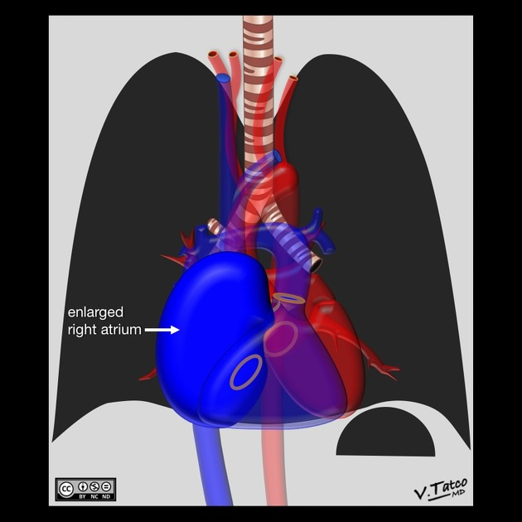
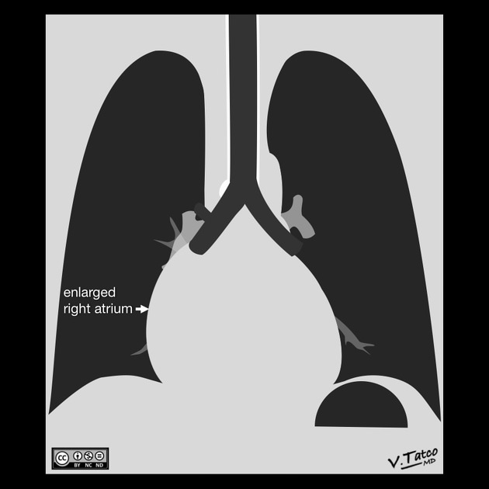
Cardiac Chambers and Great Vessels – (2/7)
Right atrial enlargement
Essentially never isolated except in the presence of congenital tricuspid atresia or the Ebstein anomaly
Gross enlargement of the RA shadow
Right atrial convexity is more than 50% of the cardiovascular height
Right atrial margin is more than 5.5 cm from the midline
Braunwald's Heart Disease: A Textbook of Cardiovascular Medicine, 10th Edition
http://radiopaedia.org/

Slide 19
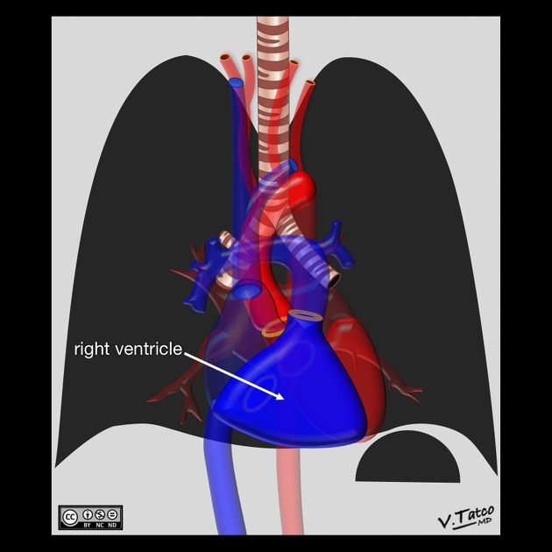
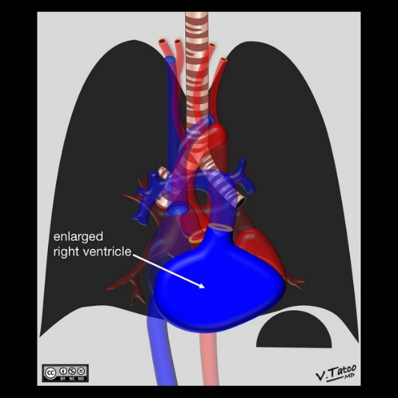
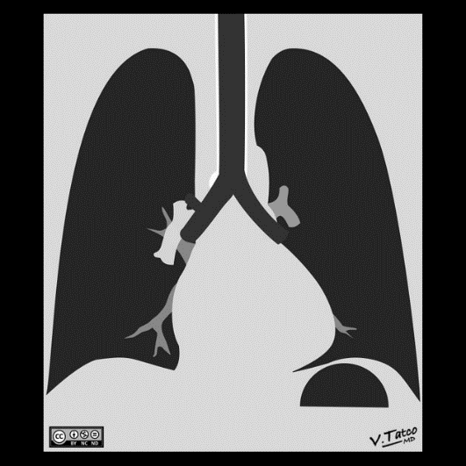
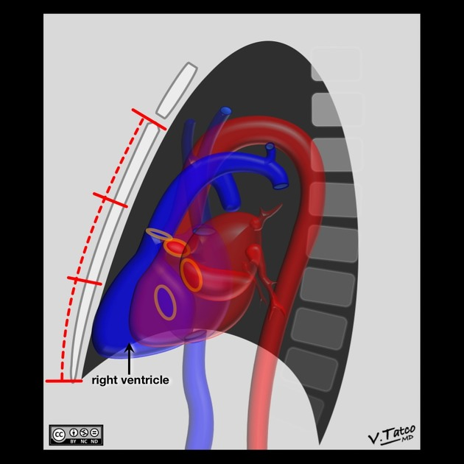
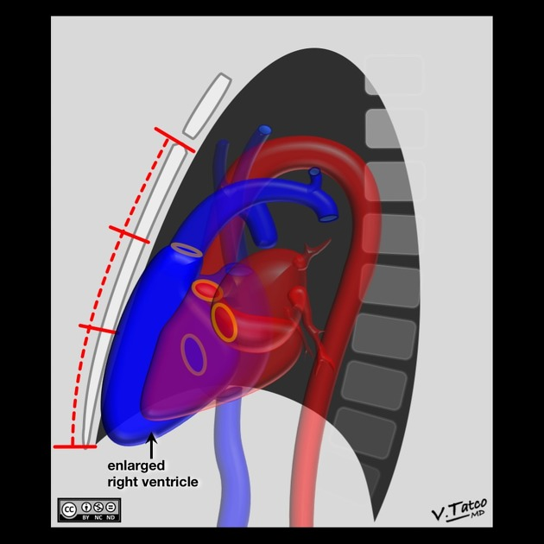
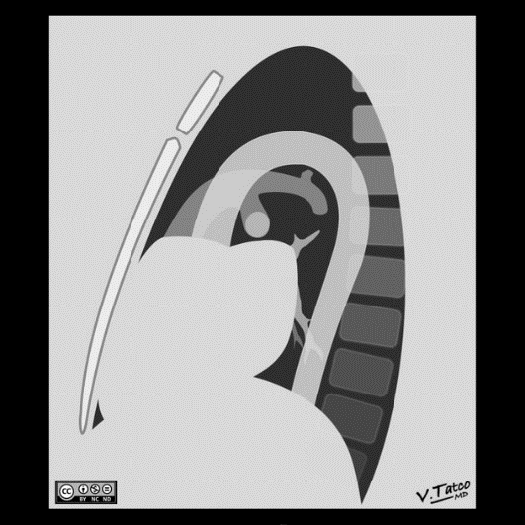
Cardiac Chambers and Great Vessels – (3/7)
Right ventricular enlargement
Boot-shaped heart (Frontal view)
Filling in of the retrosternal airspace (Lateral view)
In normal person, less than one third the distance from the suprasternal notch to the tip of the xiphoid
Rare for the RV to dilate without LV dilation
Mostly common → Tetralogy of Fallot
Braunwald's Heart Disease: A Textbook of Cardiovascular Medicine, 10th Edition
http://radiopaedia.org/

Slide 20
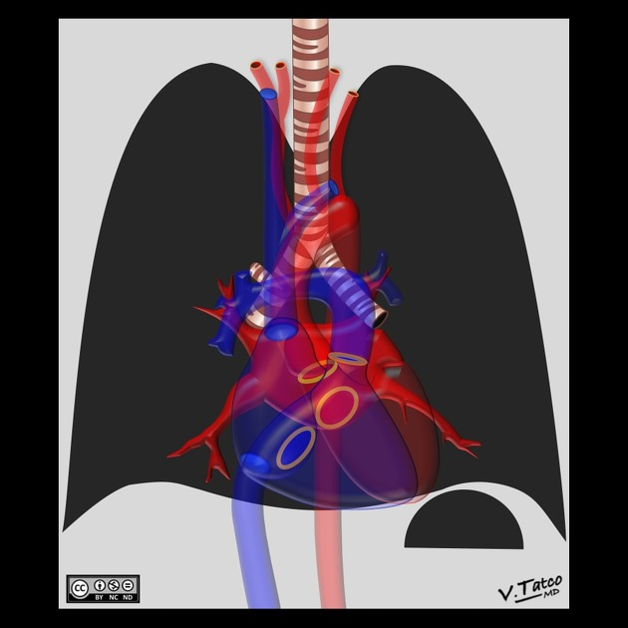
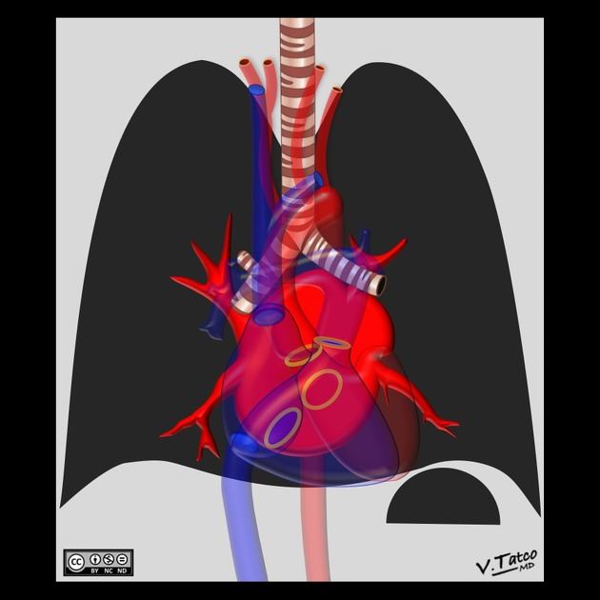
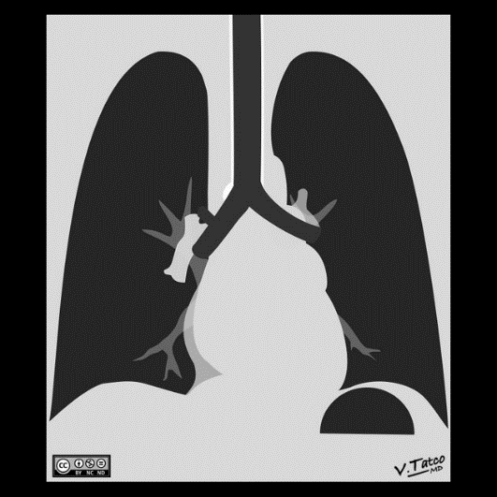
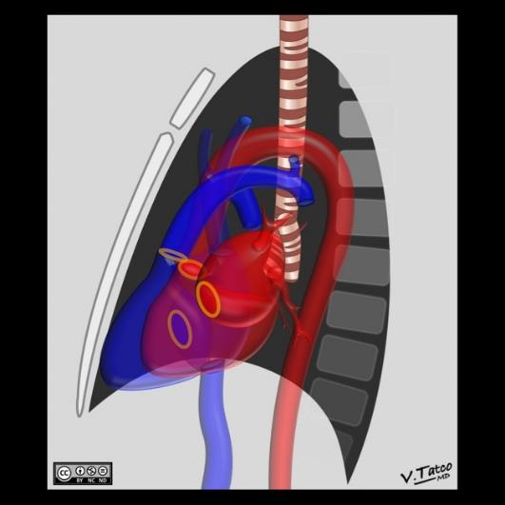
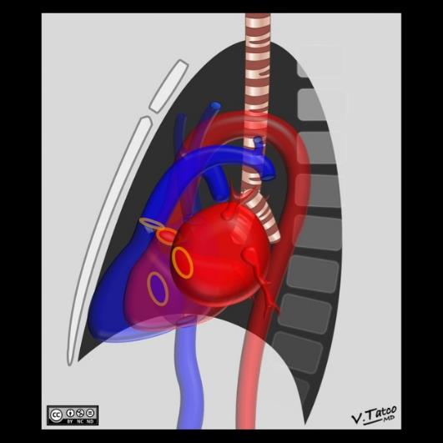
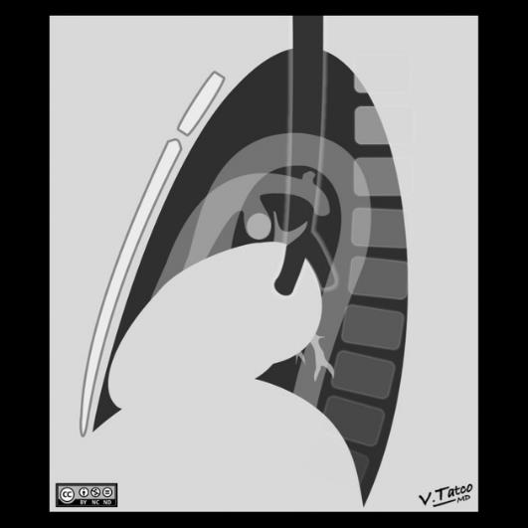
Cardiac Chambers and Great Vessels – (4/7)
Left atrial enlargement
Dilation of the LA appendage
Widening the angle of the carina (>90°)
Double density (or double contour)
Hallmark of mitral valve disease
Isolated LA enlargement → Most often in MS
Braunwald's Heart Disease: A Textbook of Cardiovascular Medicine, 10th Edition
http://radiopaedia.org/

Slide 21
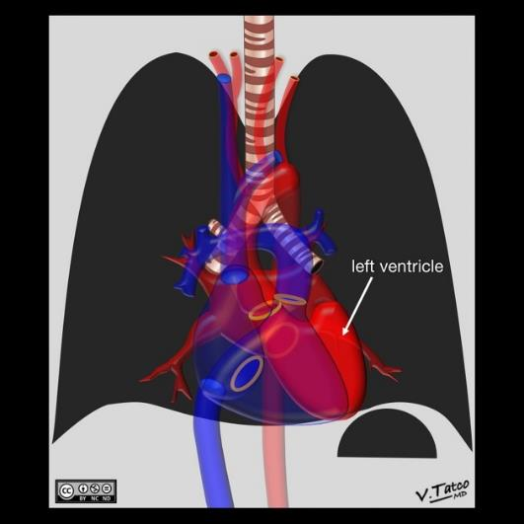
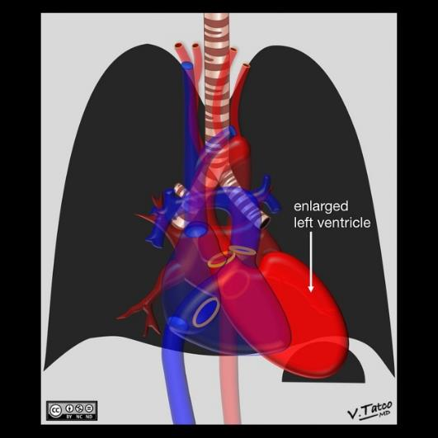
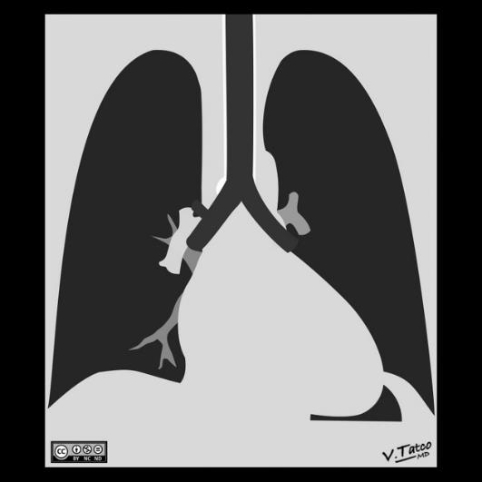
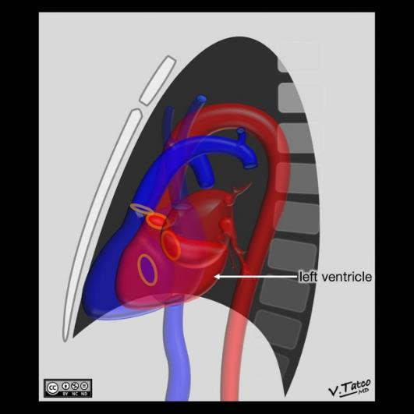
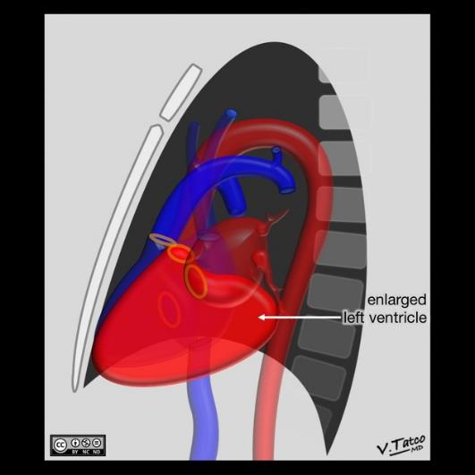
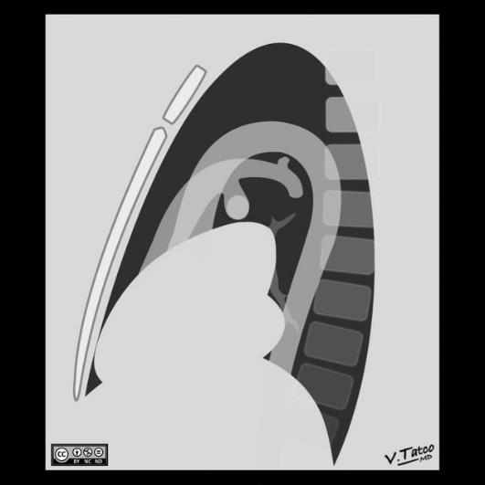
Cardiac Chambers and Great Vessels – (5/7)
Left ventricular enlargement
Prominent, downwardly directed contour of the apex (Frontal view)
posterior bulge, below the level of the mitral annulus (Lateral view)
Braunwald's Heart Disease: A Textbook of Cardiovascular Medicine, 10th Edition
http://radiopaedia.org/

Slide 22
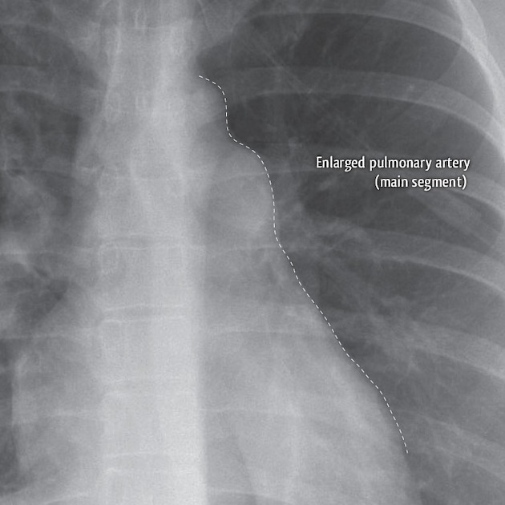
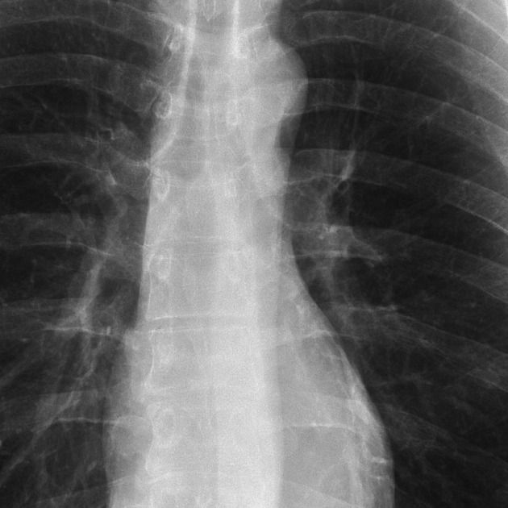
Cardiac Chambers and Great Vessels – (6/7)
Pulmonary Arteries
Pulmonic stenosis → the main pulmonary artery and left main pulmonary artery dilate
Large pulmonary emboli
Braunwald's Heart Disease: A Textbook of Cardiovascular Medicine, 10th Edition
http://radiopaedia.org/

Slide 23
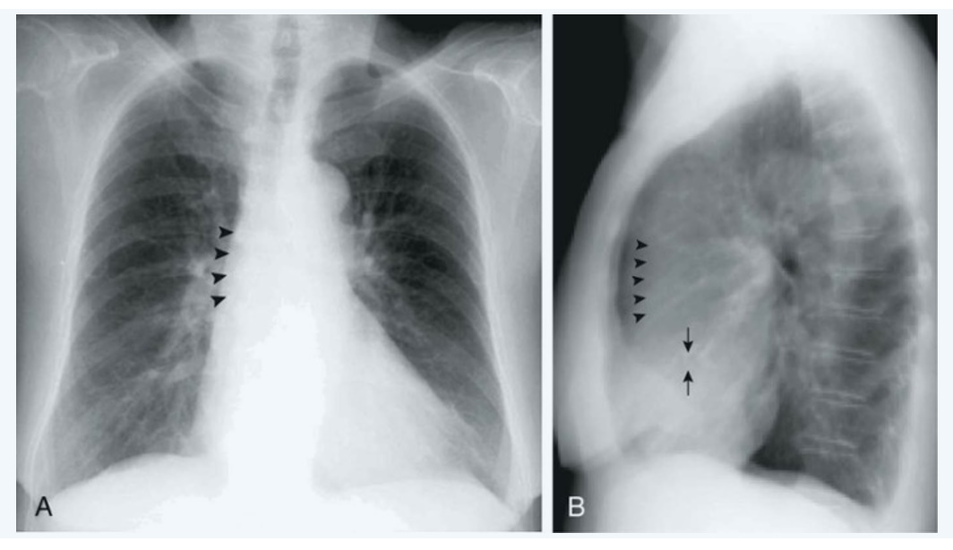
Cardiac Chambers and Great Vessels – (7/7)
Aorta
Most commonly seen abnormality → Dilation
Prominence to the right of the middle mediastinum (Frontal view)
Prominence in the anterior mediastinum (Lateral view)
Aortic valve
Calcification is pathognomonic for significant aortic valve disease but usually difficult to see on a CXR
Braunwald's Heart Disease: A Textbook of Cardiovascular Medicine, 10th Edition
Notes:
Dilation of the aortic root is seen with aortic valve disease (both stenosis and regurgitation) but more frequently has other causes, such as long-term, poorly controlled systemic hypertension or generalized atherosclerosis with ectasia.

Slide 24
Outline
Technical Considerations
General Principles
Lungs and Pulmonary Vasculature
Cardiac Chambers and Great Vessels
Pericardium
Additional Specific Considerations

Slide 25
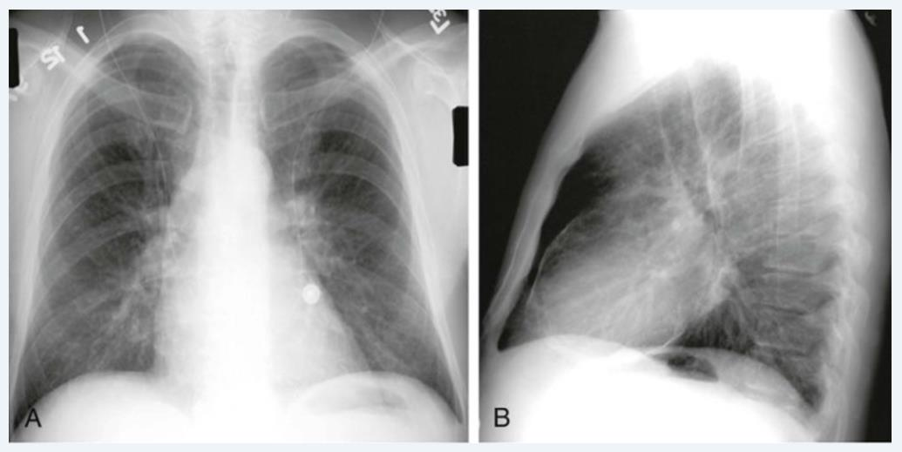
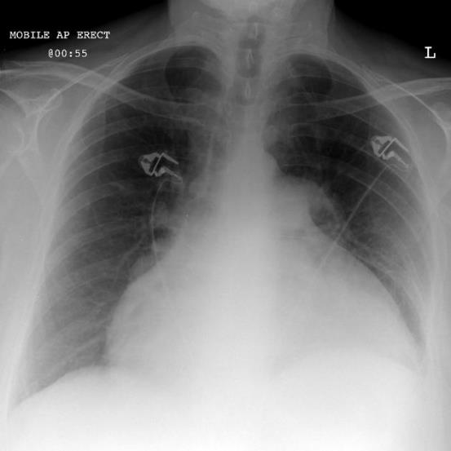
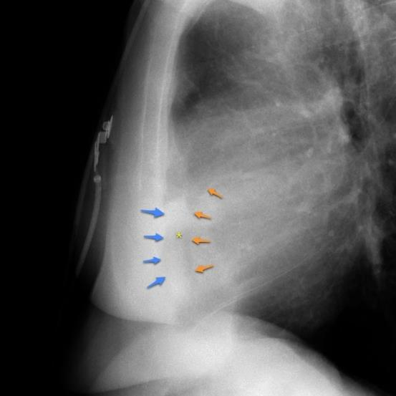
Pericardium
Pericardium is rarely distinctly definable
Two conditions:
Calcification
Large pericardial effusion
Braunwald's Heart Disease: A Textbook of Cardiovascular Medicine, 10th Edition
http://radiopaedia.org/

Slide 26
Outline
Technical Considerations
General Principles
Lungs and Pulmonary Vasculature
Cardiac Chambers and Great Vessels
Pericardium
Additional Specific Considerations

Slide 27
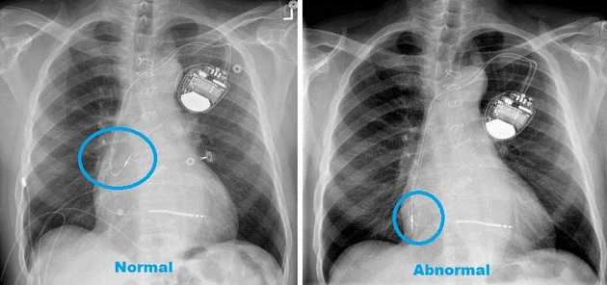
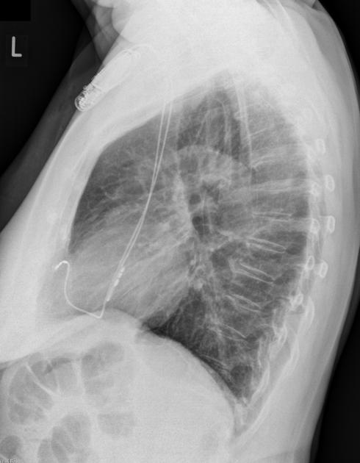
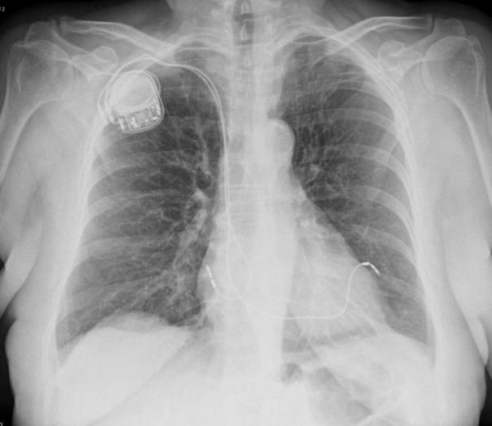
Additional Specific Considerations
Implantable Devices and Other Postsurgical Findings
The usual position of pacemaker lead
Braunwald's Heart Disease: A Textbook of Cardiovascular Medicine, 10th Edition
http://radiopaedia.org/

Slide 28
Take Home Message
CXRs provide a wealth of physiologic and anatomic information
Always considering the radiation dose
Portable CXRs should be used as infrequently as possible
Standard 6-foot frontal and lateral CXRs are almost always clinically useful
Always comparing to previous CXR if possible

Slide 29
Thank for Your Attention

