Slide 1
Atrial Septal Defect 心房中膈缺損
報告者 曾建豪

Slide 2
Atrial Septal Defect
10-15% of congenital heart defects
The 2nd most common congenital lesion found in adults (bicuspid aortic valve is the most common)
1:1500 live births have an ASD
Male: Female ratio is 1:2
Spontaneous closure is rare in children/ adults
Generally would have closed in infancy if it was going to close
Closure only seen in 4% of patients
Life expectancy is not normal, though many patients live to advanced age.
Natural survival beyond age 40-50 is <50%.
The attrition rate after age 40 is ~6% per year
First open heart closure of an atrial septal defect (ASD) on September 5th, 1952

Slide 3
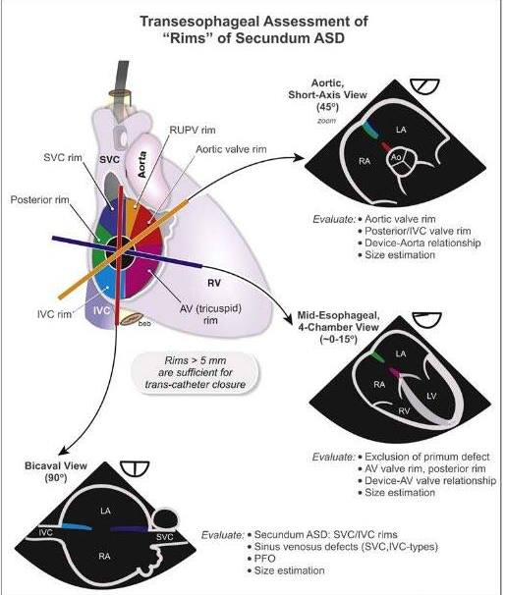
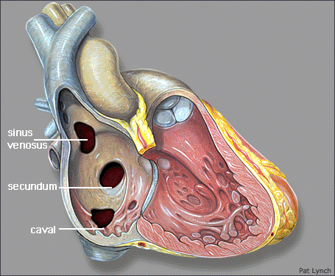
Ostium Secundum
Ostium Primum
Sinus Venosus
Coronary sinus defects

Slide 4
Ostium Secundum ASD
Most common type (70-75%)
7% of all congenital heart defects = 5-6 cases per 10,000 live births
Female predominance 2:1
Two common mechanisms:
Inadequate formation of septum secundum to not completely cover ostium secundum
Excessively large ostium secundum due to increased resorption; septum secundum can therefore not cover

Slide 5
Clinical Presentation
Often asymptomatic until 3-4th decade for moderate-large ASD
Fatigue
DOE:
30% by 3rd decade
75% by 5th decade
Atrial arrhythmias/SVT and R sided HF:
10% by 4th decade
Increase the risk with age
Paradoxical Embolus:
Transient flow reversal (Valsalva/strain)
Pulmonary Hypertension

Slide 6
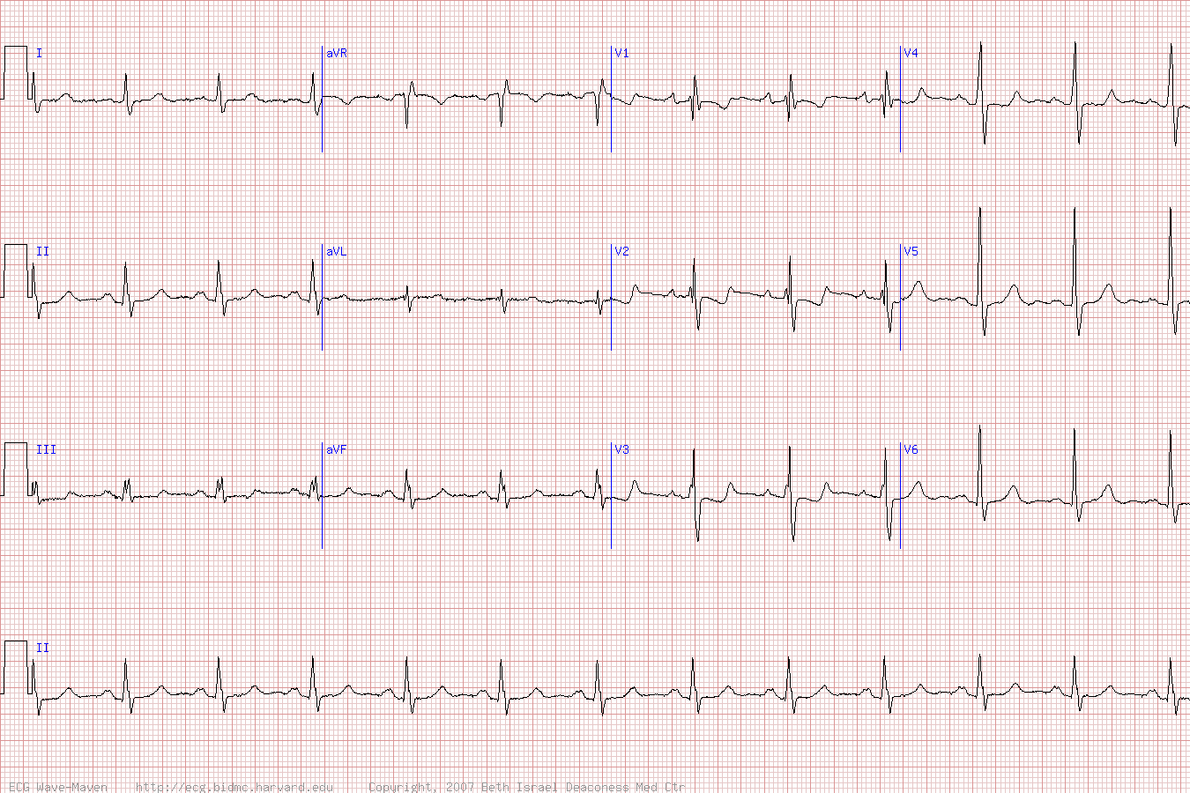
Associated Finding
MVP (10-20%)
EKG abnormalities:
RAE
Prolonged PR interval
RAD (+100°)
rSR¹ V1
rSR’ in v1 (incomplete RBBB) and notching of the R wave peak (“crochetage sign”)

Slide 7
Echo Finding
Subcostal view most reliable: US beam perpendicular to plane of septum
Other views may have loss of signal from the atrial septum from parallel alignment
Secundum ASD: central portion of atrial septum (89% sensitivity)
Primum ASD: adjacent to AV valve annuli (100% sensitivity)
Sinus Venosus defects: difficult to visualize on TTE (44% sensitivity)

Slide 8
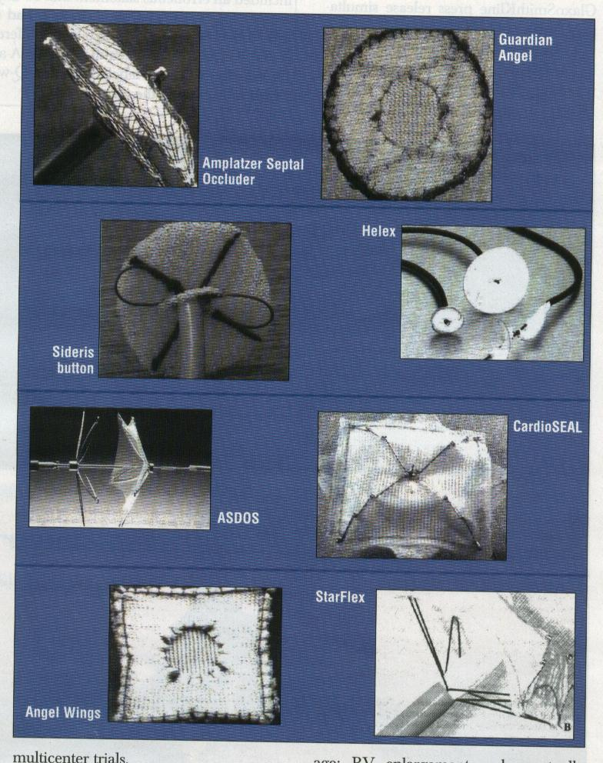
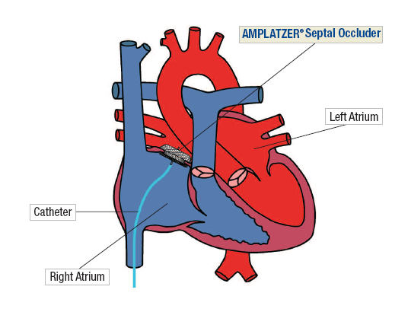
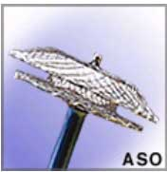
Closure Device

Slide 9
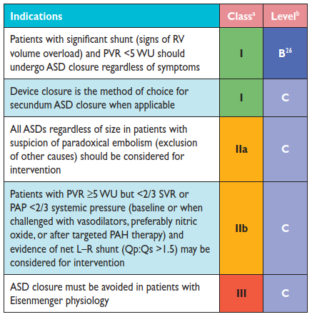
Indications for Intervention in Atrial Septal Defect

Slide 10
2018 AHA/ACC Guideline for the Management of Adults With Congenital Heart Disease A Report of the American College of Cardiology/American Heart Association Task Force on Clinical Practice Guidelines

Slide 11
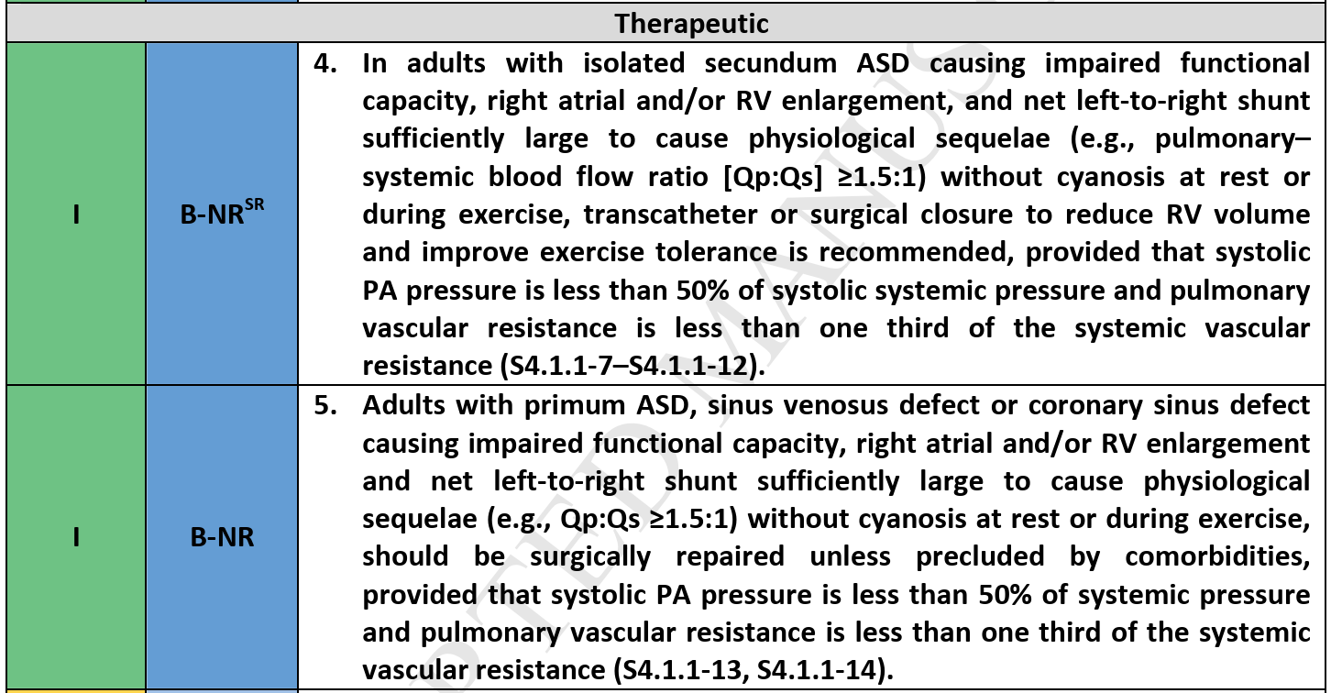
Symptomatic ASD

Slide 12
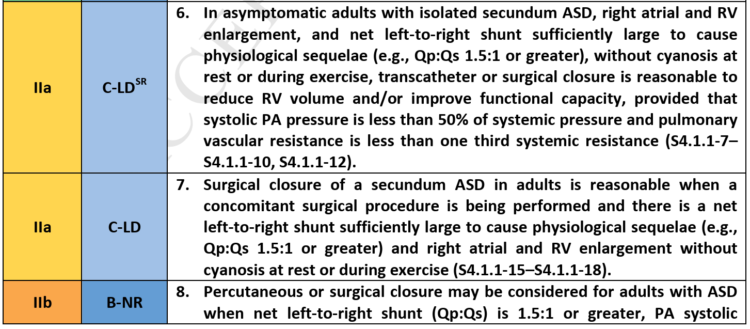

Slide 14
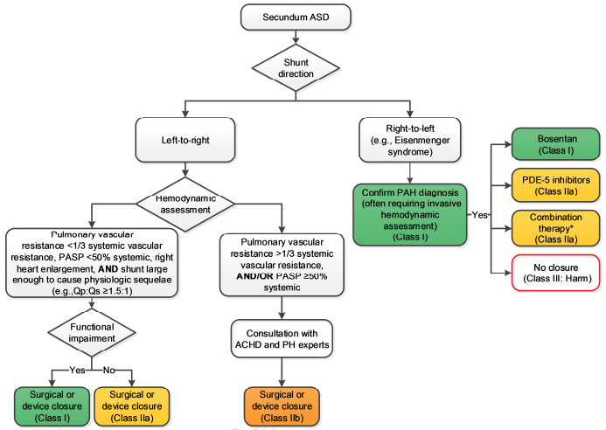

Slide 15
Take Home Message
In adults with secundum ASD and impaired functional capacity, right atrial and/or RV enlargement, Qp:Qs ≥1.5:1, and absence of cyanosis at rest or during exercise, device or surgical closure is recommended if systolic pulmonary artery pressure is <50% of systolic systemic pressure and pulmonary vascular resistance is less than 1/3 of the systemic vascular resistance (Class of Recommendation [COR] I, Level of Evidence [LOE] B-NR). For asymptomatic patients, closure is reasonable (COR IIa, LOE C-LD).

