Slide 1
Aortic stenosis
2018/09/17
Chien-Ho Lee

Slide 2
Cause and pathology
Aortic valve
Congenital bicuspid valve + calcification
Calcification of a normal trileaflet valve
Rheumatic disease
Supravalvular
Subvalvular

Slide 3
Calcified AS
Most common
> 65 y/o people, 2% had frank aortic calcification, 29% exhibited age-related aortic valve sclerosis without stenosis
Aortic sclerosis with absence of valve obstruction , also had 50% increased CV death and MI
Risk factor: ↑LDL, lipoprotein a, DM, HTN, smoking
High prevalence in patient with ESRD and Paget disease of bone

Slide 4
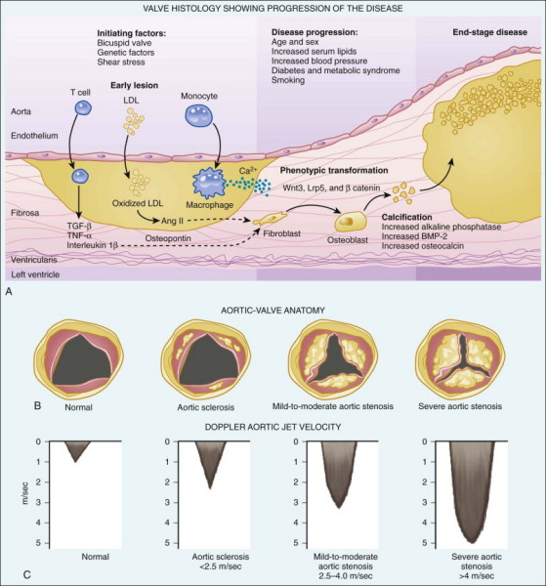

Slide 5
Rheumatic AS
Rheumatic AS results from adhesions and fusions of the commissures and cusps and vascularization of the leaflets of the valve ring, leading to retraction and stiffening of the free borders of the cusps.
Calcific nodules develop on both surfaces, and the orifice is reduced to a small round or triangular opening.
As a consequence, the rheumatic valve is often regurgitant, as well as stenotic.

Slide 6
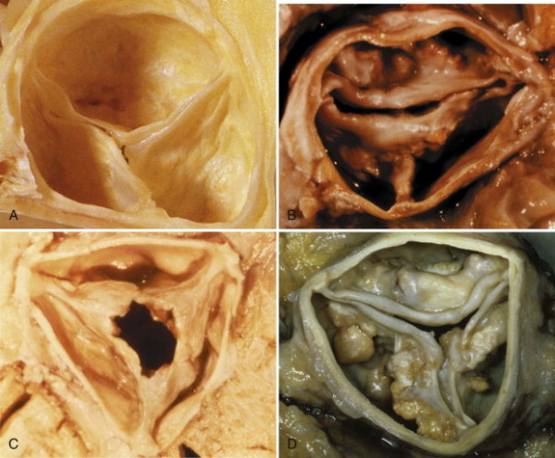

Slide 7
Severity of AS
Aortic stenosis | Mild | Moderate | Severe
Jet velocity (m/sec) | <3.0 | 3.0~4.0 | >4.0
Mean gradient (mmHg) | <25 | 25~40 | >40
Valve area (cm²) | >1.5 | 1.0~1.5 | <1.0
Valve index (cm²/m²) |  |  | <0.6

Slide 8
Stages of Valvular Aortic Stenosis
Stage | Definition | Valve Anatomy | Valve Hemodynamics | Hemodynamic Consequences | Symptoms
A | At risk of AS | Bicuspid aortic valve (or other congenital valve anomaly) Aortic valve sclerosis | Aortic V_{max} <2 m/s | None | None
B | Progressive AS | Mild-to-moderate leaflet calcification of a bicuspid or trileaflet valve with some reduction in systolic motion or Rheumatic valve changes with commissural fusion | Mild AS: Aortic V_{max} 2.0–2.9 m/s or mean ΔP <20 mm Hg Moderate AS: Aortic V_{max} 3.0–3.9 m/s or mean ΔP 20–39 mm Hg | Early LV diastolic dysfunction may be present Normal LVEF | None

Slide 9
Stages of Valvular Aortic Stenosis
Stage | Definition | Valve Anatomy | Valve Hemodynamics | Hemodynamic Consequences | Symptoms
C - Asymptomatic severe AS
C1 | Asymptomatic severe AS | Severe leaflet calcification or congenital stenosis with severely reduced leaflet opening | Aortic V_{max} ≥4 m/s or mean ΔP ≥40 mm Hg AVA typically is ≤1 cm² (or AVAi ≤0.6 cm²/m²) Very severe AS is an aortic V_{max} ≥5 m/s, or mean ΔP ≥60 mm Hg | LV diastolic dysfunction Mild LV hypertrophy Normal LVEF | None–exercise testing is reasonable to confirm symptom status
C2 | Asymptomatic severe AS with LV dysfunction | Severe leaflet calcification or congenital stenosis with severely reduced leaflet opening | Aortic V_{max} ≥4 m/s or mean ΔP ≥40 mm Hg AVA typically is ≤1 cm² (or AVAi ≤0.6 cm²/m²) | LVEF <50% | None

Slide 10
Stages of Valvular Aortic Stenosis
Stage | Definition | Valve Anatomy | Valve Hemodynamics | Hemodynamic Consequences | Symptoms
D - Symptomatic severe AS
D1 | Symptomatic severe high-gradient AS | Severe leaflet calcification or congenital stenosis with severely reduced leaflet opening | Aortic V_{max} ≥4 m/s, or mean ΔP ≥40 mm Hg AVA typically is ≤1 cm² (or AVAi ≤0.6 cm²/m²), but may be larger with mixed AS/AR | LV diastolic dysfunction LV hypertrophy Pulmonary hypertension may be present | Exertional dyspnea or decreased exercise tolerance Exertional angina Exertional syncope or presyncope
D2 | Symptomatic severe low-flow/low-gradient AS with reduced LVEF | Severe leaflet calcification with severely reduced leaflet motion | AVA ≤1 cm² with resting aortic V_{max} <4 m/s or mean ΔP <40 mm Hg Dobutamine stress echo shows AVA ≤1 cm² with V_{max} ≥4 m/s at any flow rate | LV diastolic dysfunction LV hypertrophy LVEF <50% | HF, Angina, Syncope or presyncope

Slide 11
Stages of Valvular Aortic Stenosis
Stage | Definition | Valve Anatomy | Valve Hemodynamics | Hemodynamic Consequences | Symptoms
D - Symptomatic severe AS
D3 | Symptomatic severe low-gradient AS with normal LVEF or paradoxical low-flow severe AS | Severe leaflet calcification with severely reduced leaflet motion | AVA ≤1 cm² with aortic V_{max} <4 m/s, or mean ΔP <40 mm Hg Indexed AVA ≤0.6 cm²/m² and Stroke volume index <35 mL/m² Measured when the patient is normotensive (systolic BP <140 mm Hg) | Increased LV relative wall thickness Small LV chamber with low-stroke volume. Restrictive diastolic filling LVEF ≥50% | HF, Angina, Syncope or presyncope

Slide 12
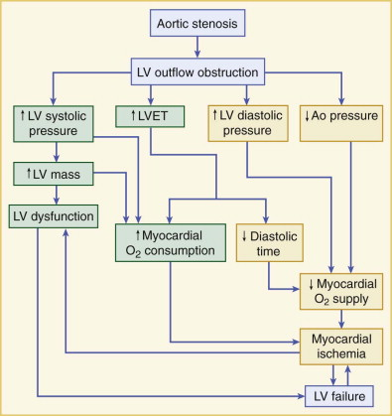
Large a wave
Concentric hypertrophy
Coronary artery perfusion
Notes:
Pathophysiology of aortic stenosis. LV outflow obstruction results in an increased LV systolic pressure, increased LV ejection time (LVET), increased LV diastolic pressure, and decreased aortic (Ao) pressure. Increased LV systolic pressure with LV volume overload increases LV mass, which may lead to LV dysfunction and failure. Increased LV systolic pressure, LV mass, and LVET increase myocardial oxygen (O2) consumption. Increased LVET results in a decrease of diastolic time (myocardial perfusion time). Increased LV diastolic pressure and decreased Ao diastolic pressure decrease coronary perfusion pressure. Decreased diastolic time and coronary perfusion pressure decrease myocardial O2 supply. Increased myocardial O2 consumption and decreased myocardial O2 supply produce myocardial ischemia, which further deteriorates LV function. (From Boudoulas H, Gravanis MB: Valvular heart disease. In Gravanis MB [ed]: Cardiovascular Disorders: Pathogenesis and Pathophysiology. St. Louis, CV Mosby, 1993, p 64.)

Slide 13
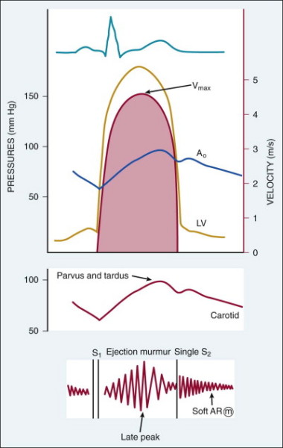
PHYSICAL EXAMINATION
Carotid palpation
Slow rise and late peak
Murmur
crescendo-decrescendo late-peaking
louder and later (severe)
S2 split
Single S2
A2 inaudible (immobile)
A2=P2
Paradoxical splitting (LBBB, LV dysfunction)
Sigs of heart failure
Notes:
Relationship between LV and aortic (Ao) pressures and the Doppler aortic stenosis velocity curve (in red). The pressure difference between the left ventricle and aorta in systole is four times the velocity squared (the Bernoulli equation). Thus, a maximum velocity (Vmax) of 4.3 m/sec corresponds to a maximum LV to Ao pressure difference of 74 mm Hg and a mean systolic gradient of 44 mm Hg. On physical examination, the slow rate of rise and delayed peak in the carotid pulse (or parvus and tardus) matches the contour of the aortic pressure waveform. The murmur corresponds to the Doppler velocity curve with a harsh crescendo-decrescendo late-peaking systolic murmur, best heard at the aortic region (upper right sternal border). Often, a soft, high-pitched diastolic decrescendo murmur of aortic regurgitation also is appreciated.

Slide 14
Symptom
Asymptomatic patients
10~15 years, long latent
Mild to moderate stenosis
Aortic sclerosis
1 year follow up: 16% develop obstruction
8 years follow up: only 2.5% will develop severe obstruction
Symptomatic patients
Even mild, survival rate is poor
The risk of sudden death is high with symptomatic severe AS

Slide 15
Symptoms
Exertional dyspnea
↑LVEDP, PHT
Limited C.O.
Angina (5 years )
2/3 of severe AS
50% had significant CAD
Syncope (3 years)
Fixed C.O.
reduced cerebral perfusion that occurs during exertion
Transient Af at rest
Heart failure (2 years)
Others:
GIB (angiodysplasia , most commonly of the right colon)
IE, cerebral emboli

Slide 16
Medical Treatment

Slide 17
Medical treatment
Symptomatic patients with severe AS
cautioned to avoid vigorous athletic sports and physical activity
medical therapy has little to offer.
Fluid accumulation: caution use of diuretics
LV dysfunction: caution use of ACEi
B-blocker: avoided
depress myocardial function and induce LV failure
2D echography follow up
Severe AS annually, 1~2 years for moderate AS and 3~5 years for mild AS

Slide 18
Af/Atial flutter
<10%
Af with RVR -> angina
Sudden fall in cardiac output -> severe hypotension
should be treated promptly, usually with cardioversion
HTN or CAD
started at low doses and slowly titrated upward
Adults with asymptomatic severe AS can undergo noncardiac surgery and pregnancy, but eleactive AVR prior to noncardiac surgery or a planned pregnancy may be considered

Slide 19
Aortic Stenosis: Medical Therapy
Recommendations | COR | LOE
Hypertension in patients at risk for developing AS (stage A) and in patients with asymptomatic AS (stages B and C) should be treated according to standard GDMT, started at a low dose, and gradually titrated upward as needed with frequent clinical monitoring | I | B
Vasodilator therapy may be reasonable if used with invasive hemodynamic monitoring in the acute management of patients with severe decompensated AS (stage D) with New York Heart Association (NYHA) class IV HF symptoms | IIb | C

Slide 20
Aortic Stenosis: Medical Therapy
Recommendations | COR | LOE
Statin therapy is not indicated for prevention of hemodynamic progression of AS in patients with mild-to-moderate calcific valve disease (stages B to D) | III: No Benefit | A

Slide 21
Surgical interention

Slide 22
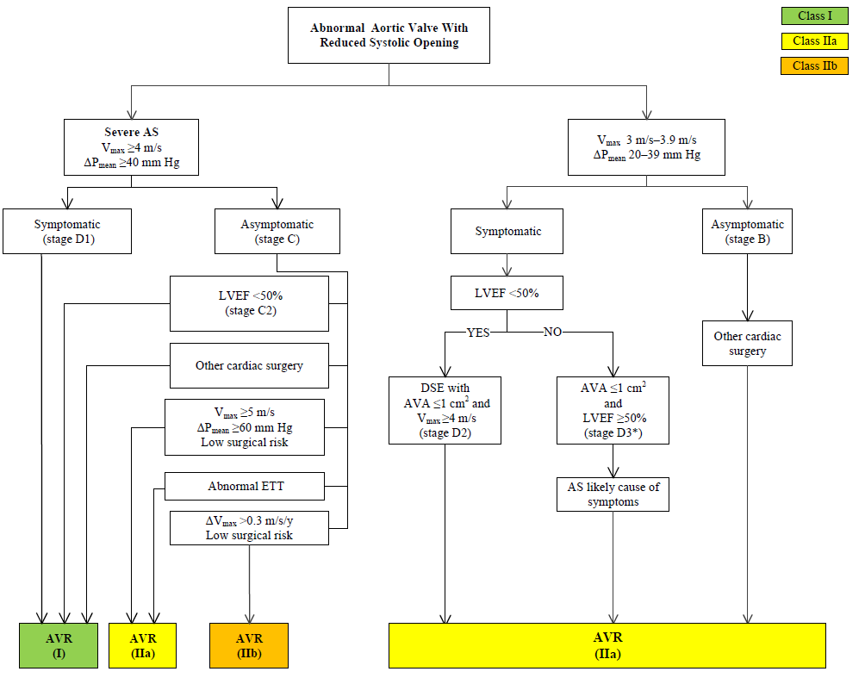
Indications for Aortic Valve Replacement in Patients With Aortic Stenosis

Slide 24
Aortic Stenosis: Choice of Intervention
Recommendations | COR | LOE
Modified: Surgical AVR is recommended for symptomatic patients with severe AS (Stage D) and symptomatic patients with severe AS (Stage C) who meet an indication for AVR when surgical risk is low or intermediate | I | B-NR
For patients in whom TAVR or high-risk surgical AVR is being considered, a heart valve team consisting of an integrated, multidisciplinary group of healthcare professionals with expertise in VHD, cardiac imaging, interventional cardiology, cardiac anesthesia, and cardiac surgery should collaborate to provide optimal patient care | I | C
Modified: Surgical AVR or TAVR is recommended for symptomatic patients with severe AS (Stage D) and high risk for surgical AVR, depending on patient-specific procedural risks, values, and preferences | I | A

Slide 25
Aortic Stenosis: Choice of Intervention (cont.)
Recommendations | COR | LOE
Modified: TAVR is recommended for symptomatic patients with severe AS (Stage D) and a prohibitive risk for surgical AVR who have a predicted post-TAVR survival greater than 12 months | I | A
New: TAVR is a reasonable alternative to surgical AVR for symptomatic patients with severe AS (Stage D) and an intermediate surgical risk, depending on patient-specific procedural risks, values, and preferences | IIa | B-R

Slide 26
Aortic Stenosis: Choice of Intervention (cont.)
Recommendations | COR | LOE
Percutaneous aortic balloon dilation may be considered as a bridge to surgical or transcatheter AVR in severely symptomatic patients with severe AS | IIb | C
TAVR is not recommended in patients in whom the existing comorbidities would preclude the expected benefit from correction of AS | III: No Benefit | B

Slide 27
Choice of TAVR Versus Surgical AVR in the Patient With Severe Symptomatic AS (Modified)

Slide 36
Low-gradient AS

Slide 37
Low-flow, low-gradient AS
defined as a valve area smaller than 1.0 cm2, LV ejection fraction less than 40% and mean gradient less than 30 to 40 mm Hg.
Dobutamine echocardiography
Severe AS: ↑ aortic velocity to at least 4 m/sec at and valve area <1.0 cm²
Not severe AS: valve area > 1.0 cm²
myocardial contractile reserve (↑ stroke volume or ejection fraction > 20% from baseline)

Slide 38
BAV

Slide 39
Indications for balloon valvuloplasty (2012 ESC guideline)
5.4.2 Balloon valvuloplasty may be considered as a bridge to surgery or TAVI in haemodynamically unstable patients who are at high risk for surgery, or in patients with symptomatic severe AS who require urgent major non-cardiac surgery (recommendation class IIb, level of evidence C). Balloon valvuloplasty may also be consid- ered as a palliative measure in selected individual cases when surgery is contraindicated because of severe comorbidities and TAVI is not an option.)

Slide 40
ACC/AHA 2014 guideline
1. Percutaneous aortic balloon dilation may be considered as a bridge to surgical AVR or TAVR in patients with severe symptomatic AS. (Level of Evidence: C)
Percutaneous aortic balloon dilation has an important role in treating children, adolescents, and young adults with AS, but its role in treating older patients is very limited. The mechanism by which balloon dilation modestly reduces the severity of stenosis in older patients is by fracture of calcific deposits within the valve leaflets and, to a minor degree, stretching of the annulus and separation of the calcified or fused commissures. Immediate hemodynamic results include a moderate reduction in the transvalvular pressure gradient, but the postdilation valve area rarely exceeds 1.0 cm². Despite the modest change in valve area, an early symptomatic improvement usually occurs. However, serious acute complications, including acute severe AR and restenosis and clinical deterioration, occur within 6 to 12 months in most patients. Therefore, in patients with AS, percutaneous aortic balloon dilation is not a substitute for AVR.

Slide 41
Some clinicians contend that despite the procedural morbidity and mortality and limited long-term results, percutaneous aortic balloon dilation can have a temporary role in the management of some symptomatic patients who are not initially candidates for surgical AVR or TAVR. For example, patients with severe AS and refractory pulmonary edema or cardiogenic shock might benefit from percutaneous aortic balloon dilation as a “bridge” to AVR; an improved hemodynamic state may reduce the risks of TAVR or surgery. In some patients, the effects of percutaneous aortic balloon dilation on symptoms and LV function may be diagnostically helpful as well, but many clinicians recommend proceeding directly to AVR in these cases. The indications for palliative percutaneous aortic balloon dilation in patients in whom AVR cannot be recommended because of serious comorbid conditions are even less well established, with no data to suggest improved longevity; however, some patients do report a decrease in symptoms. Most asymptomatic patients with severe AS who require urgent noncardiac surgery can undergo surgery at a reasonably low risk with anesthetic monitoring and attention to fluid balance. Percutaneous aortic balloon dilation is not recommended for these patients. If preoperative correction of AS is needed, they should be considered for AVR.

Slide 42
A, Increase in cardiac output and in mean aortic valve gradient from 24 to 47 mm Hg. Aortic valve area (AVA) remained 0.8 cm2. This patient underwent successful valve replacement.
B, Increase in cardiac output and minimal increase in mean pressure gradient from 17 to 20 mm Hg. The final calculated aortic valve area was 0.7 cm2. The patient was found to have only minimal AS at the time of surgery.
C, No change in cardiac output, with decrease in mean pressure gradient from 37 to 26 mm Hg in response to dobutamine. The test was terminated because of hypotension.

Slide 46
Bicuspid Aortic Valve Disease

Slide 47
Bicuspid aortic valve
Incidence: 1~2%, Men (70~80%)
Aortopathy, degeneration of the aortic media
The risk of aortic dissection in patients with a bicuspid aortic valve is five to nine times higher than the general population
Over their lifetime, approximately 20% of patients with bicuspid valves develop severe AR requiring AVR between 10 and 40 years of age, develop calcific valve stenosis later in life, typically presenting with severe AS after 50 years of age.
No effective medical therapies to prevent progressive valve deterioration
Management: directed as AS or AR
Notes:
A

Slide 48
Thank You

