Slide 1
Mini-Symposium . Palpation artery pulse
心臟內科 陳煌中醫師

Slide 2
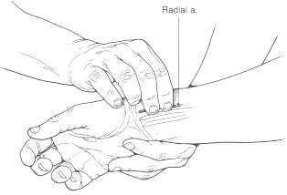
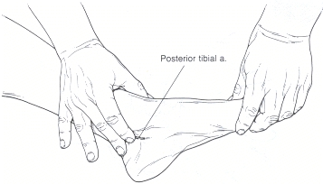
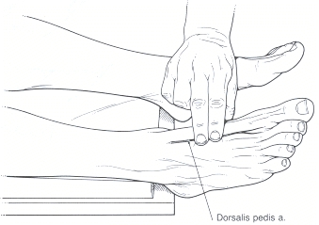
Assessment of the Arterial Pulse
檢查: rate, amplitude(contour, upstroke) , symmetry
carotid (central aortic pulse), brachial (peripheral pulse), radial
femoral, popliteal, posterior tibial, dorsalis pedis
0: no palpable pulse
1+: faint pulse
2+: slightly↓pulse
3+: normal pulse
4+: bounding pulse
不建議用thumb摸，因為易與自己的pulse混淆，可聽心音來辨別p‘t的pulse

Slide 3
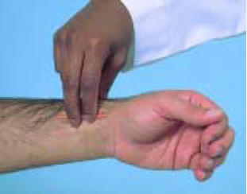
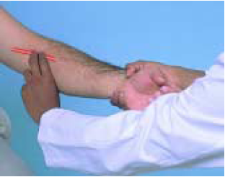
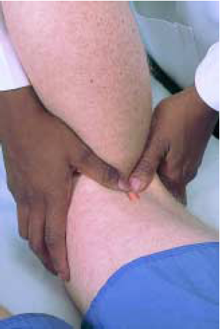
Bates’ Guide to PE and History Taking, 8th Edition

Slide 4
The Heart as a Pump
Cardiac output = stroke volume x heart rate
Stroke volume取決於preload, myocardial contractility, afterload.
＊HR < 40可能造成pumping failure → pulmonary edema
Preload (≈ venous return to the right heart)
收縮前RV loading了多少volume of blood
Myocardial contractility
increases when stimulated by the sympathetic nervous system
decreases when impaired blood flow or oxygen to myocardium
Afterload
LV收縮對抗vascular resistance (最主要是small arteries & arterioles)

Slide 5
Arterial Pulses and Blood Pressure
改變下列四點其中之一都會影響BP
Left ventricular stroke volume
Distensibility of the aorta and the large arteries
Peripheral vascular resistance, particularly at the arteriolar level
Volume of blood in the arterial system
BP隨著下列情況改變：
physical activity, emotion, pain, noise, environmental temperature
the use of coffee, tobacco, and other drugs
the time of day

Slide 6
Arterial Pressure
Systolic pressure: Maximum pressure (peak of arterial pressure wave)
Diastolic pressure: Minimum pressure (trough of arterial pressure wave)
Pulse pressure: SBP – DBP = 脈壓 (normal range 30~50mmHg) ≈ 脈搏強弱
Pulse pressure = SV / compliance
→ stroke volume(正相關) 與 arterial compliance(負相關)
老人：動脈硬化
→ compliance↓= SV (↓or -) / pulse pressure↑
Mean arterial pressure：指在cardiac cycle的平均血壓
Formula: DBP + 1/3 (pulse pressure)
＊在HR=60的前提下，若太快systole佔的比例會增加，變不準

Slide 7
Wide Pulse Pressure
Compliance↓(= diastolic BP↓)
Atherosclerosis
Old age = ateriosclerosis
Aortic dissection
Vasodilators
Stroke Volume↑ (= systolic BP↑)
有漏洞：Aorta conditions (AR)、Patent ductus arteriosus (PDA)
Infective endocarditis
Hypertension
Severe bradycardia
Raised intracranial pressure
Heart block
High C.O.
Fever、Anemia、Anxiety
Graves disease
Beri beri
Pregnancy
Wrong technique

Slide 8
AS, congenital fibrous subaortic stenosis, LV fialure
Tardus et Pavus
AR/MR, artherosclerosis, arteriosclerosis,
bradycardia, Congenital (ASD, VSD, PDA),
Drugs(↓afterload)
hyperkinetic heart syndrome,
sympathetic hyperactivity, anxiety, anemia, fever, hyperthyroid, pregnancy
Pulse pressure > 50 mmHg
Carotid, usually not palpable
pure AR, AR+AS, HCM, LV failure
Regular, >20 mmHg
LV failure, exagerated by AR,
systemic hypertension,
↓venous return by NTG or uprighting
frequently precipitated by a PVC
ventricular bigeminy, digoxin overdose
Irregular
cardiac tamponade, constrictive pericarditis, pulmonary embolism, hypovolemic shock, COPD/asthma,
pregnancy, extreme obesity
> 10 mmHg

Slide 9
Asymmetric Arterial Pulsation
Carotid or Arms (R’t≠L’t)
Vessel anatomic
Aortic dissection or Aneurysm
Carotid or subclavian artery atherosclerosis
Takayasu disease (pulseless disease)
Supravalvular aortic stenosis
a selective streaming of the jet toward the innominate artery, the carotid and brachial arterial pulses are stronger and rise more rapidly on the right than on the left side
Congenital: anomalous origin ; aberrant path of major vessels
Thromboemboli: arterial embolus or thrombosis
Compression: cervical rib or Scalenus anticus syndrome
Differential Pulse (Arms > Legs)
Coarctation of the aorta
Asymmetry of right and left popliteal pulses
Iliofemoral obstruction

Slide 10
Definition and Classification of HTN by Office BP

Slide 11
Correct Methods for Office BP (1)
Before measurement
Timing
1 hour: Avoiding coffee, food, smoking, decongestants
30 minutes: Avoiding exercise
5 minutes: Sitting calmly
Preparation: Emptying bladder and bowel, and removing all clothing that covers the location of cuff placement
Environment: Calm and warm place

Slide 12
Correct Methods for Office BP (2)
During measurement
Body position: Seated, back supported, legs uncrossed, feet flat on floor, and relaxed
Arm: Supported, using the arm with higher value
Cuff: at heart level, using appropriate sized one
Measurement:
Taking two measurement, spaced 1-2 minutes apart, and additional measurement if needed
Measuring heart rate by pulse palpation (at least 30 seconds) after the second measurement
For patients with atrial fibrillation, measuring blood pressure manually, using direct auscultation over the brachial artery
When suspecting orthostatic hypotension, measuring blood pressure 1 and 3 minutes after assumption of standing position

Slide 13
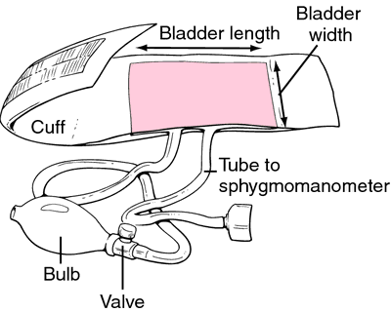
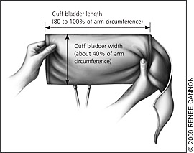
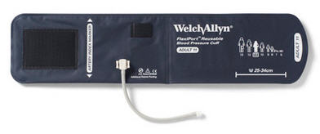

Slide 14
Correct Methods for Office BP (3)
After measurement
Blood pressure readings
Averaging, but not rounding them
Recording

