Slide 1
跨領域團隊照護
高血磷治療
20220324

Slide 2
現狀用藥
Calcium carbonate 500mg/tab 3pc TID
Vitamin B complex tab 1pc QD
Folic acid 5mg/tab 1pc QD
Epoetin beta 2000iu/0.3ml 1pc
Iron sucrose complex 2% 1pc QW
Rosuvastatin 10mg/tab 1pc QD
Carvedilol 6.25mg/tab 1pc QN

Slide 3
高血磷治療(透析病人)
Phosphate restriction
Phosphate binders
Calcium carbonate
Calcium acetate
Aluminum hydroxide
Lanthanum
Sevelamer carbonate
Ferric citrate
Calcium-containing binders

Slide 4
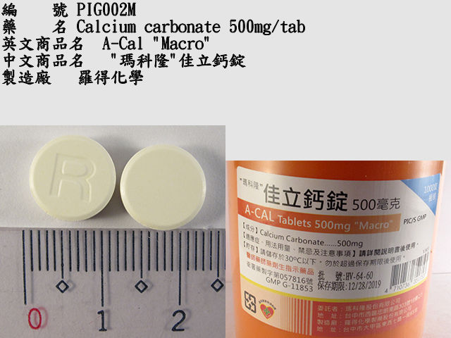
Calcium carbonate 500mg/tab (elemental Ca 200mg)
Hyperphosphatemia in chronic kidney disease
Total dose of elemental calcium provided by the calcium-based phosphate binders should not exceed 1500mg/day
Total intake of elemental calcium (including dietary calcium) should not exceed 2 g/day
Administer with food
Side effect : Hypercalcemia、milk-alkali syndrome、constipation、nausea, vomiting

Slide 5
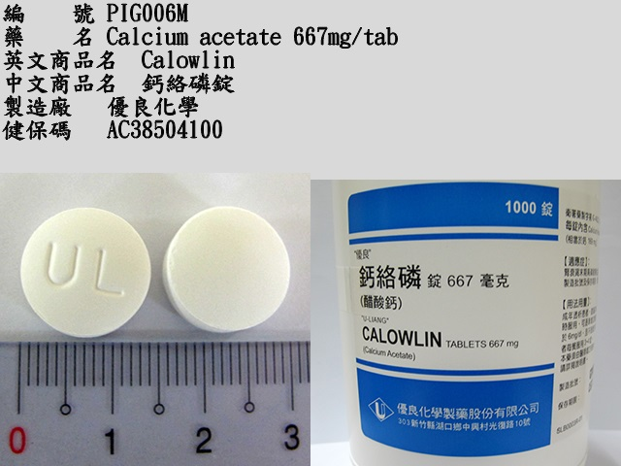
Calcium acetate 667mg/tab (elemental Ca 169mg)
Control of serum phosphorus (ESRD , on dialysis)
1334mg with each meal (usual dose : 2001~2668mg),do not give additional calcium supplements
Can be increased gradually (ie,every 2 to 3 weeks) to bring the serum phosphate to target range as long as hypercalcemia dose not develop
Side effect : Hypercalcemia、diarrhea、nausea、vomiting

Slide 6
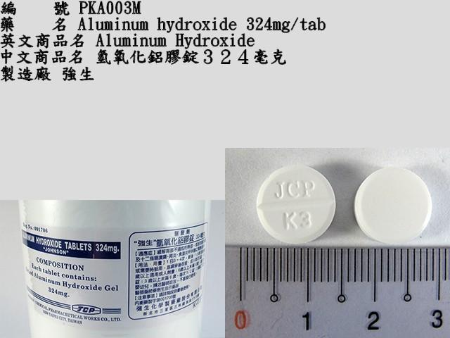
Aluminum hydroxide 324mg/tab
Hyperphosphatemia in chronic kidney disease, refractory (alternative agent) (off-label use)
For short-term use (≤4 weeks) in patients with severe hyperphosphatemia (eg, serum phosphorus levels >7 mg/dL) despite treatment with other nonaluminum phosphate binders
Long-term use has been associated with aluminum toxicity
Initial: 300 to 600 mg 3 times daily with meals
Side effect : Constipation、stomach cramps、vomiting、aluminum intoxication

Slide 7
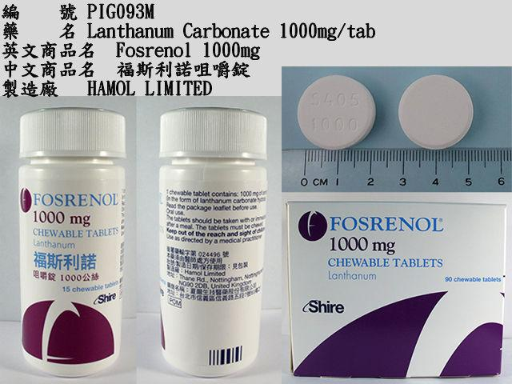
Lanthanum Carbonate 1000mg/tab
Reduction of serum phosphate in patients with ESRD
Initial : 1,500 mg daily divided and taken with or immediately after meals typical increases of 750 mg daily every 2 to 3 weeks usual dosage range: 1,500~3,000 mg daily; up to 4,500 mg have been evaluated
Chewable tablet: should be chewed completely prior to swallowing Unchewed or incompletely chewed tablets may cause serious GI complications
Side effect : Diarrhea、nausea、vomiting、Hypocalcemia、Abdominal pain

Slide 8
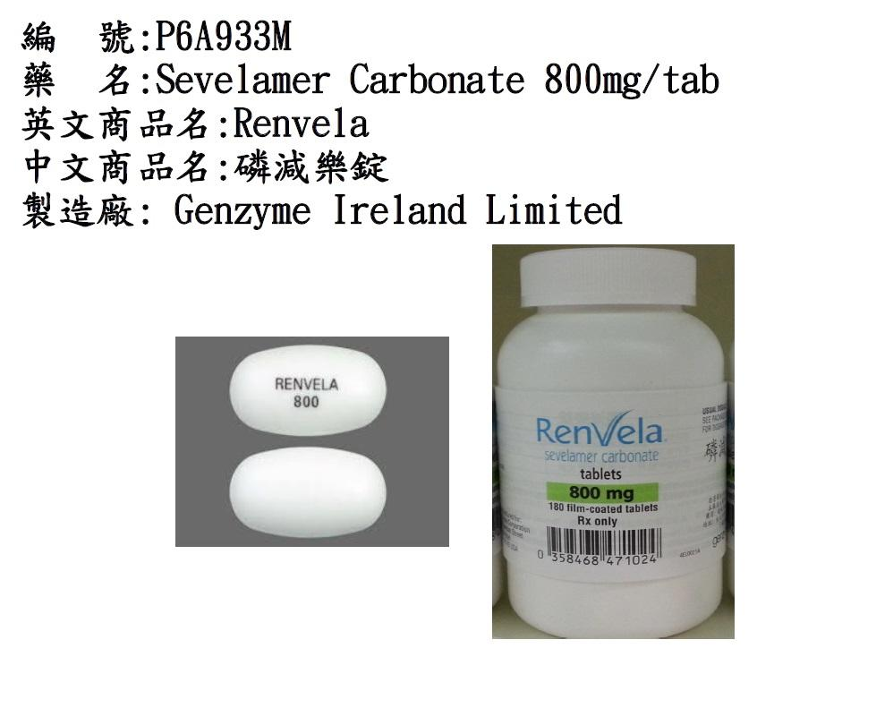
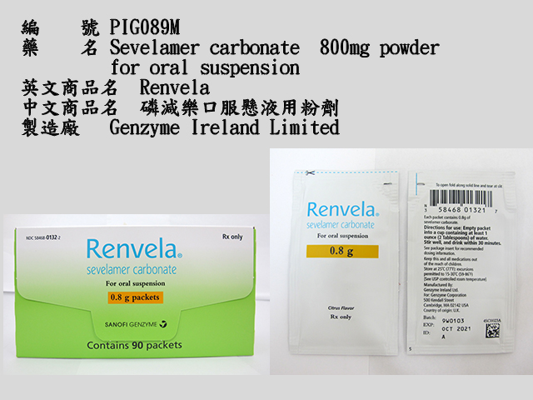
Sevelamer carbonate
Control of serum phosphorous in patients with CKD on hemodialysis
Initial : 800~1,600 mg 3 times daily with meals; >5.5 to <7.5 mg/dL: 800 mg 3 times daily
≥7.5 to <9 mg/dL: 1,200 to 1,600 mg 3 times daily
≥9 mg/dL: 1,600 mg 3 times daily
Maintenance dose adjustment (goal range of 3.5 to 5.5 mg/dL; maximum dose : 14 g/day)
>5.5 mg/dL: Increase by 400 to 800 mg per meal at 2-week intervals
3.5 to 5.5 mg/dL: Maintain current dose
<3.5 mg/dL: Decrease by 400 to 800 mg per meal

Slide 9
Sevelamer carbonate
Powder for oral suspension: Empty contents of 0.8 g powder packet in at least 30 mL of water or 2.4 g powder packet in at least 60 mL of water and stir vigorously (does not dissolve) or may premix the entire content of the packet with a small amount of food or beverage (do not heat or add to heated foods or liquids)
Preparations should be consumed immediately or within 30 minutes. Oral suspension in water may need to be resuspended immediately before drinking
Side effect : Diarrhea、dyspepsia、nausea、vomiting
May cause reductions in vitamin D, E, K, or folic acid absorption Consider vitamin supplementation

Slide 10
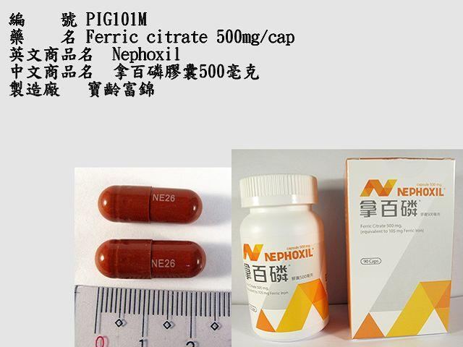
Ferric citrate 500mg/cap
Hyperphosphatemia in patients with CKD receiving dialysis
Initial: 2g orally (420 mg ferric iron) 3 times daily
Maintenance: Increase or decrease dose by 1 or 2 g (ferric iron 210 mg to 420 mg) as needed at 1-week or longer intervals to achieve target serum phosphorus levels (maximum dose: 12g [ferric iron 2,520 mg] daily)
Swallow tablets whole; do not crush or chew
Side effect : Darkening of stools、diarrhea、constipation、nausea
Iron supplements: Patients receiving parenteral iron supplementation may require a dose reduction or discontinuation when ferric citrate is initiated

Slide 11
Phosphate binders
 | Advantage | Disadvantage
Calcium carbonate | Inexpensive | Hypercalcaemia, large doses required to be effective, vascular calcification
Aluminum hydroxide | Inexpensive, calcium-free | potential central nervous system toxicity
Lanthanum | Calcium-free, lipid-lowering effect | Expensive, GI adverse effects (bloating)
Sevelamer | Low pill burden, high efficacy, works in wide range of pH, no negative changes on bone histology | Expensive, GI adverse effects, uncertain long-term effects
Ferric citrate | Low pill burden, works in wide range of pH, minimal systemic absorption | Expensive, GI adverse effects (stool discoloration)

Slide 12
Conclusion
長期服用鈣片可能會增加高血鈣、血管鈣化…等等之風險,若病患之經濟能力許可,且可耐受副作用的情況下,建議可以考慮使用新一代的磷結合劑或樹脂型磷結合劑,並配合飲食上限制磷的攝取以控制高血磷及減少高血鈣之風險,搭配定期監測血磷濃度調整藥物劑量。

Slide 13
參考資料
UpTodate
Micromedex

